Slide 1
Multi Skin Cancer Classification and Segmentation
Multi Skin Cancer Classification and Segmentation
BY
Mr. R. Bhanu Prakash 21BQ1A4285
Ms. M. Jyothsna 21BQ1A42B0
Mr. K. Ganesh 21BQ1A42C6
Mr. K. Avinash 21BQ1A42C7
UNDER THE GUIDANCE OF
Mr. B. Pardha Saradhi, Assistant Professor
Multi Skin Cancer Classification and Segmentation

Slide 2
Multi Skin Cancer Classification and Segmentation
Content | Slide Number
Introduction | 3
Problem statement, Over View & Objectives | 4,5,6
Existing Vs Proposed Systems & System Architecture | 7,8
Tech Stack | 9
Module-1 | 10-13
Module-2 | 14-19
Module-3 | 20-23
Expected Outputs | 24,25
Challenges, Future Scope & Conclusion | 26-28
Multi Skin Cancer Classification and Segmentation

Slide 3
Multi Skin Cancer Classification and Segmentation
Introduction:
Title: Multi Skin Cancer Classification and Segmentation
Content:
Skin cancer is one of the most common types of cancer worldwide, with increasing prevalence and mortality rates. Early detection is crucial for improving outcomes and preventing complications. This project, "Multi Skin Cancer Classification and Segmentation", leverages deep learning techniques to automate the detection and classification of skin cancer.
The system uses Convolutional Neural Networks (CNN) for classification and U-Net++ for segmentation to identify and delineate skin lesions. It also integrates features like real-time camera capture, multi-language support, and appointment booking to enhance user experience and accessibility.
The goal of the project is to provide an efficient, accessible, and accurate tool for skin cancer detection, enabling early diagnosis and timely medical consultation.
Multi Skin Cancer Classification and Segmentation

Slide 4
Multi Skin Cancer Classification and Segmentation
Problem Statement :
Skin cancer is a major global health concern, with early detection playing a critical role in improving survival rates. However, traditional diagnostic methods are often time-consuming and prone to human error. There is a lack of accessible and efficient tools for self-screening, especially in regions with limited access to dermatologists or healthcare resources.
Additionally, most existing solutions rely on manual assessments, which can be subjective and inconsistent. With the increasing demand for quick, reliable, and accurate skin cancer detection, there is a need for a system that can:
Automate skin cancer classification and segmentation
Provide real-time feedback for users
Ensure accessibility for diverse populations via multi-language support
Facilitate easy access to medical professionals through appointment booking systems
Multi Skin Cancer Classification and Segmentation

Slide 5
Multi Skin Cancer Classification and Segmentation
Project Overview :
This project introduces a comprehensive system for Multi Skin Cancer Classification and Segmentation, aimed at automating the detection and classification of skin cancer. The system integrates advanced deep learning models (CNN for classification and U-Net++ for segmentation) to accurately analyze skin lesions.
Key features include:
Real-Time Detection: Allows users to capture and analyze skin lesions instantly through their device's camera.
Image Upload Functionality: Enables users to upload high-quality images for more detailed analysis.
Chatbot Assistance: Provides instant skin health advice and guidance on whether to seek medical attention.
Appointment Booking: Facilitates the scheduling of dermatology appointments directly from the platform.
Multi-Language Support: Ensures accessibility to a global audience by offering the platform in various languages.
The system aims to improve accessibility, reduce diagnostic errors, and provide users with quick feedback on potential skin health concerns.
Multi Skin Cancer Classification and Segmentation

Slide 6
Multi Skin Cancer Classification and Segmentation
Project Objectives :
The primary objectives of the Multi Skin Cancer Classification and Segmentation project are:
Early Detection of Skin Cancer: Provide an automated solution for detecting and classifying skin cancer at an early stage using deep learning techniques.
Accurate Classification and Segmentation: Implement CNN for skin cancer classification and U-Net++ for precise segmentation of skin lesions, ensuring reliable results.
Real-Time Feedback: Offer real-time analysis of skin lesions through camera capture, allowing users to instantly assess potential risks.
User Accessibility: Ensure the platform is accessible to a global audience by incorporating multi-language support and a user-friendly interface.
Enhance Healthcare Access: Integrate appointment booking functionality for seamless access to dermatologists and healthcare professionals.
Improve Skin Cancer Awareness: Provide valuable information on skin cancer prevention, risk factors, and treatment options through integrated chatbot assistance.
Multi Skin Cancer Classification and Segmentation

Slide 7
Multi Skin Cancer Classification and Segmentation
Existing vs. Proposed Systems
Existing Systems:
Manual Diagnosis: Skin cancer detection is often based on visual inspection by dermatologists, which can be subjective and prone to errors.
Limited Accessibility: Many existing systems are not widely accessible to individuals in remote areas or without easy access to healthcare providers.
Slow Diagnosis: Traditional methods require patients to visit dermatologists, wait for an appointment, and undergo tests, leading to delays in diagnosis.
Lack of Integration: Many systems lack integrated features like appointment booking, real-time detection, and multi-language support, which limits their usability.
Proposed System:
Automated Detection and Classification: Uses deep learning models (CNN and U-Net++) to automate and enhance the accuracy of skin cancer classification and segmentation.
Real-Time Feedback: Provides instant analysis through real-time camera capture, allowing immediate feedback on skin lesions.
Global Accessibility: Multi-language support makes the system accessible to a broader, international audience.
Seamless Healthcare Access: Integrated appointment booking system allows users to schedule consultations directly with dermatologists.
Comprehensive User Assistance: A chatbot offers instant advice, skin health tips, and guidance on whether users need professional consultation, improving accessibility and awareness.
Multi Skin Cancer Classification and Segmentation

Slide 8
Multi Skin Cancer Classification and Segmentation
System Architecture :
+-------------------------+
| Camera Feed | <---> Real-Time Skin Cancer Detection (CNN Model)
+-------------------------+
|
v
+------------------------------------------+
| Skin Cancer Classification & Detection |
| (CNN for Classification) |
+------------------------------------------+
|
v
+------------------------------------------+
| Skin Cancer Segmentation (U-Net++) |
+------------------------------------------+
|
v
+------------------------------------------+
| Chatbot Integration (Perplexity API) |
+------------------------------------------+
|
v
+------------------------------------------+
| Appointment Booking System |
+------------------------------------------+
|
v
+------------------------------------------+
| Multi-Language Support |
+------------------------------------------+
Multi Skin Cancer Classification and Segmentation

Slide 9
Multi Skin Cancer Classification and Segmentation
Explanation:
Camera Feed: Users can upload or capture real-time images of skin lesions.
Skin Cancer Classification & Detection (CNN Model): The captured or uploaded images are processed by the classification model to identify potential skin cancer.
Skin Cancer Segmentation (U-Net++): The U-Net++ model highlights the areas of concern in the lesion, providing a visual segmentation for better understanding.
Chatbot Integration (Perplexity API): The chatbot offers real-time information, guidance, and advice based on the analysis results.
Appointment Booking System: Allows users to schedule appointments with dermatologists for further examination and consultation.
Multi-Language Support: Ensures the system is accessible to users from different regions by providing language options.
Multi Skin Cancer Classification and Segmentation

Slide 10
Multi Skin Cancer Classification and Segmentation
Module 1: Skin Cancer Classification using CNN- Overview
Purpose:
The primary purpose of Module-1 is to automate the classification of skin lesions using deep learning techniques. By leveraging a Convolutional Neural Network (CNN), the module is capable of distinguishing between various types of skin cancer (e.g., melanoma, basal cell carcinoma, benign nevi) and providing accurate predictions.
Key Sections:
Data Collection:
CNN Model Design:
Model Training:
Classification Results:
Multi Skin Cancer Classification and Segmentation

Slide 11
Multi Skin Cancer Classification and Segmentation
Module 1: UI – Section Details
User Interface Features:
Image Upload Section:
Upload Button: Users can easily upload images of their skin lesions for classification.
Drag and Drop Option: Allows users to directly drag and drop images for faster interaction.
Supported File Formats: Accepts common image formats like JPEG, PNG, and BMP for easy uploads.
Real-Time Camera Capture:
Camera Activation: Users can activate their device's camera to capture live images of their skin lesions.
Preview Screen: The preview screen provides users with a real-time view of their skin lesion, ensuring proper alignment and clarity for analysis.
Capture Button: Once aligned, users can click the capture button to take a snapshot for analysis.
Multi Skin Cancer Classification and Segmentation

Slide 12
Multi Skin Cancer Classification and Segmentation
3.Result Display Section:
Classification Result: The interface displays the skin cancer type (e.g., melanoma, benign nevi, etc.) based on the CNN classification model's output.
Confidence Score: A confidence percentage is shown alongside the classification result, indicating the certainty of the prediction.
Visual Indicator: A color-coded visual (e.g., green for benign, red for malignant) gives a quick overview of the result.
4.Additional Information:
Skin Cancer Tips: Provides users with general information on skin health, prevention tips, and when to seek professional consultation.
Call-to-Action Button: A button linking to the appointment booking system for users who need further consultation with dermatologists.
5.Accessibility Options:
Multi-Language Support: Users can choose their preferred language from a dropdown to ensure a personalized experience.
High Contrast Mode: A high-contrast mode option for users with visual impairments.
Multi Skin Cancer Classification and Segmentation

Slide 13
Multi Skin Cancer Classification and Segmentation
User Authentication
Implemented using Django’s built-in authentication system.
Signup: New users create an account.
Login: Existing users access personalized recommendations.
Logout: Users can securely log out after their session.
Security Features: Secure password hashing, session management
Multi Skin Cancer Classification and Segmentation

Slide 14
Multi Skin Cancer Classification and Segmentation
Module-2 Overview: Skin Cancer Segmentation using U-Net++
Purpose:
The purpose of Module-2 is to perform precise segmentation of skin lesions using the U-Net++ deep learning architecture. This module is designed to highlight and delineate the affected areas of the skin lesions in images, offering a visual representation of the lesion's boundaries for better diagnosis and treatment planning.
Key Sections:
Data Preparation for Segmentation:
U-Net++ Architecture:
Model Training:
Segmentation Output:
Multi Skin Cancer Classification and Segmentation

Slide 15
Multi Skin Cancer Classification and Segmentation
Deployment & Integration:
The Multi Skin Cancer Classification and Segmentation system is deployed on cloud platforms or local servers for scalability and real-time access via web or mobile apps. It integrates several components, including camera/image upload for real-time detection, a chatbot for skin health advice, an appointment booking system for dermatology consultations, and multi-language support for global accessibility.
Why This Matters:
Accessibility: The integration of various components makes it easy for users to interact with the system from anywhere, promoting wider use and quicker responses.
Scalability: Cloud deployment allows the system to handle large numbers of users and continually update based on new data and feedback.
Efficiency: By combining real-time detection, image upload, segmentation, and appointment booking, the system provides a one-stop solution for skin cancer detection and management.
User Trust: Seamless integration between diagnostic models, user interfaces, and external systems ensures that users receive accurate results and can take necessary actions like consulting a dermatologist.
Multi Skin Cancer Classification and Segmentation

Slide 16
Multi Skin Cancer Classification and Segmentation
Module-2: Data Preparation for Segmentation & Implementation
The goal of this module is to ensure that the images fed into the U-Net++ segmentation model are properly prepared and processed to allow the model to effectively learn and segment skin lesions. Data preparation is a crucial step in improving the model's ability to perform accurate and reliable segmentation, which is vital for diagnosing skin cancer.
– Implementation
Technical Steps:
Input: User uploads a skin image or uses a webcam for live capture.
Preprocessing: Resize and normalize the image/video to prepare it for segmentation.
Segmentation: A deep learning model (like U-Net++) segments the skin areas from the background.
Display Results: Segmented regions (skin lesions or cancerous areas) are highlighted for user identification.
Error Handling: If no skin is detected or the input is invalid, an error message is shown.
Real-Time Updates (for webcam): If using a webcam, skin areas are segmented and updated in real-time.
Result: Users can view segmented areas of interest (like skin lesions) on the uploaded image or live video feed, helping them identify possible skin cancer regions.
Multi Skin Cancer Classification and Segmentation

Slide 17
Multi Skin Cancer Classification and Segmentation
Flow of Segmentation Implementation
Input Image: The preprocessed image is fed into the U-Net++ model for segmentation.
Encoder: The model’s encoder (contracting path) extracts key features from the image, capturing high-level information about the lesion.
Nested Skip Pathways: These pathways help retain and refine fine-grained spatial information, improving the model's ability to segment even small or poorly defined lesions.
Decoder: The decoder (expansive path) reconstructs the image with a focus on accurate lesion boundaries, generating the final segmentation mask.
Output Mask: The model outputs a binary segmentation mask that highlights the regions affected by the lesion, providing a visual representation of the skin cancer.
Multi Skin Cancer Classification and Segmentation

Slide 18
Multi Skin Cancer Classification and Segmentation
Deployment & Integration
Deployment:
The U-Net++ model for segmentation is deployed on the cloud or a local server, ensuring scalability and availability.
It is integrated into the overall system where users can upload images or capture them in real time for instant analysis.
The model can be updated regularly with new data and improved models, enhancing segmentation accuracy over time.
Embedding:
The segmentation output is embedded into the user interface, where it is overlaid on the original image, providing users with a visual representation of the detected lesion and its boundaries.
Users can interact with the results, viewing detailed segmented areas of concern for further analysis.
Multi Skin Cancer Classification and Segmentation

Slide 19
Benefits:
Improved Diagnosis: Segmentation provides accurate boundaries for skin lesions, helping dermatologists identify the size, shape, and severity of cancerous areas.
Real-Time Assistance: The system provides immediate segmentation results, enabling faster decisions and action.
Higher Accuracy: The U-Net++ model improves segmentation accuracy by effectively handling complex lesion shapes and varied skin tones.
User Empowerment: The visual nature of segmentation allows users to better understand the detected lesions, increasing their awareness and involvement in their health.
Scalability and Flexibility: The system is easily scalable to handle more users and can be expanded with additional datasets or models for further improvements.

Slide 20
Module-3: Chatbot Integration and Appointment Booking System
Purpose:
The purpose of Module-3 is to enhance user engagement and streamline healthcare access by integrating a chatbot and appointment booking system. The chatbot provides real-time guidance on skin health, while the appointment booking system allows users to schedule consultations with dermatologists directly through the platform.

Slide 21
Multi Skin Cancer Classification and Segmentation
Module 3: Chatbot – Conversation FlowLogic:
Flow of Chatbot and Appointment Booking System
User Interaction:
Users can interact with the chatbot, asking questions related to skin cancer or general skin health.
If the chatbot detects a potential concern (e.g., a suspicious skin lesion), it prompts the user to schedule an appointment.
Chatbot Response:
The chatbot provides tailored responses based on the user’s input. It can also suggest further actions, such as seeking medical advice or taking specific steps to monitor the skin lesion.
Appointment Booking:
After receiving guidance, users can click the Appointment Booking button to access available dermatologists and choose a convenient time.
Once the appointment is scheduled, a confirmation is sent to both the user and the healthcare provider.
Reminder and Follow-Up:
The system sends reminders to users before the appointment and ensures the dermatologist is aware of the consultation.
Multi Skin Cancer Classification and Segmentation

Slide 22
Multi Skin Cancer Classification and Segmentation
Integration in Django:
Django as the Core Framework:
Django serves as the backbone of the Multi Skin Cancer Classification and Segmentation platform. It handles the primary backend functionality, including URL routing, user authentication, and overall site structure. Django ensures a smooth, secure, and scalable user experience from login screens to navigation menus. This provides consistency across the platform, allowing seamless interactions between different modules and user interfaces.
Modular Embedding:
The project is divided into distinct modules, each of which is integrated into the Django framework while maintaining modularity for easier maintenance and updates.
Module 1 (User Interface): This module is developed using Django templates and views, serving as the main landing page and navigation menus. It manages how users interact with the platform, including uploading images, viewing results, and navigating between different sections of the platform.
Module 2 (Skin Cancer Classification & Segmentation): The core functionality of skin cancer classification and segmentation is integrated into Django, with the machine learning models deployed on a separate platform, such as Hugging Face Spaces. This module is displayed within the Django interface using <iframe> components, allowing users to interact with the classification and segmentation tools without leaving the site.
Module 3 (Interactive Chatbot): The chatbot is integrated similarly, allowing users to engage with it directly through the Django-hosted interface. This ensures that all features, from skin cancer detection to personalized health advice, are accessible within the same platform, maintaining a unified user experience.
Multi Skin Cancer Classification and Segmentation

Slide 23
Multi Skin Cancer Classification and Segmentation
Unified User Experience: Single sign-on with Django’s authentication system, allowing users to move seamlessly between career exploration, skill-gap analysis, real-time job searches, and the chatbot.
Consistent design elements and navigation structure provide a cohesive, professional look and feel.
Advantages:
Instant Access to Information: The chatbot enables users to quickly get answers to their skin health-related questions without waiting for a consultation.
Streamlined Appointment Scheduling: The integration of the appointment booking system saves users time, allowing them to easily book dermatology appointments.
Enhanced User Engagement: Users are encouraged to take proactive steps in managing their skin health by receiving immediate assistance and easy access to healthcare providers.
Improved Healthcare Access: The system bridges the gap between users and dermatologists, especially for individuals who may not have immediate access to a healthcare provider.
Multi Skin Cancer Classification and Segmentation

Slide 24
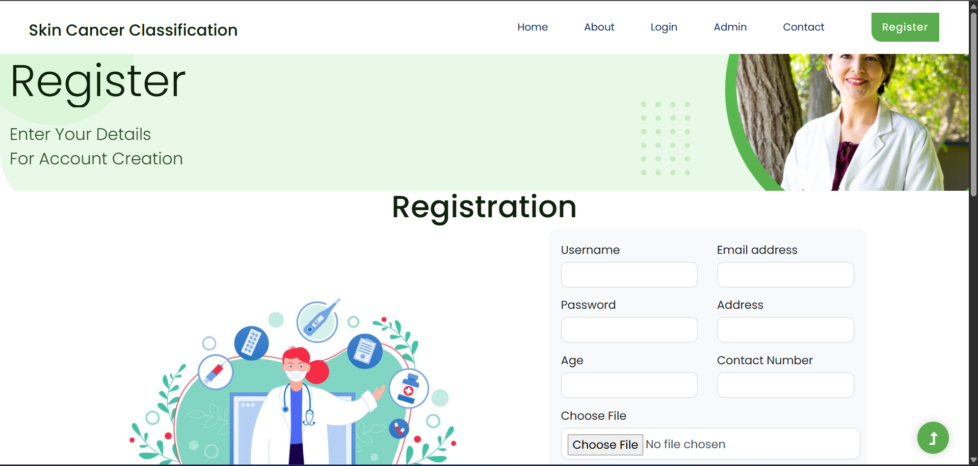
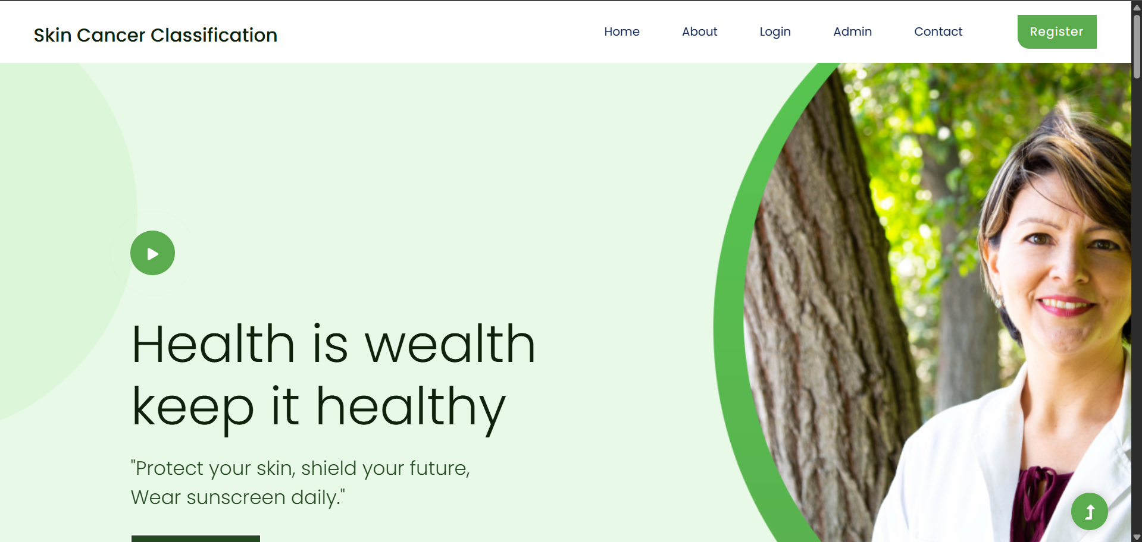
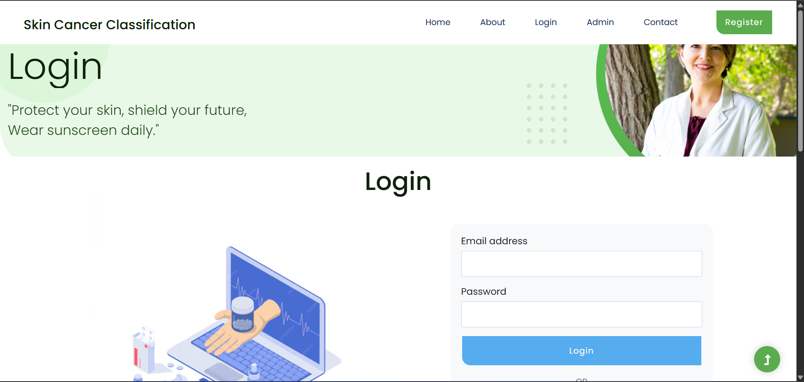
Multi Skin Cancer Classification and Segmentation
Expected Outputs:
Multi Skin Cancer Classification and Segmentation

Slide 25
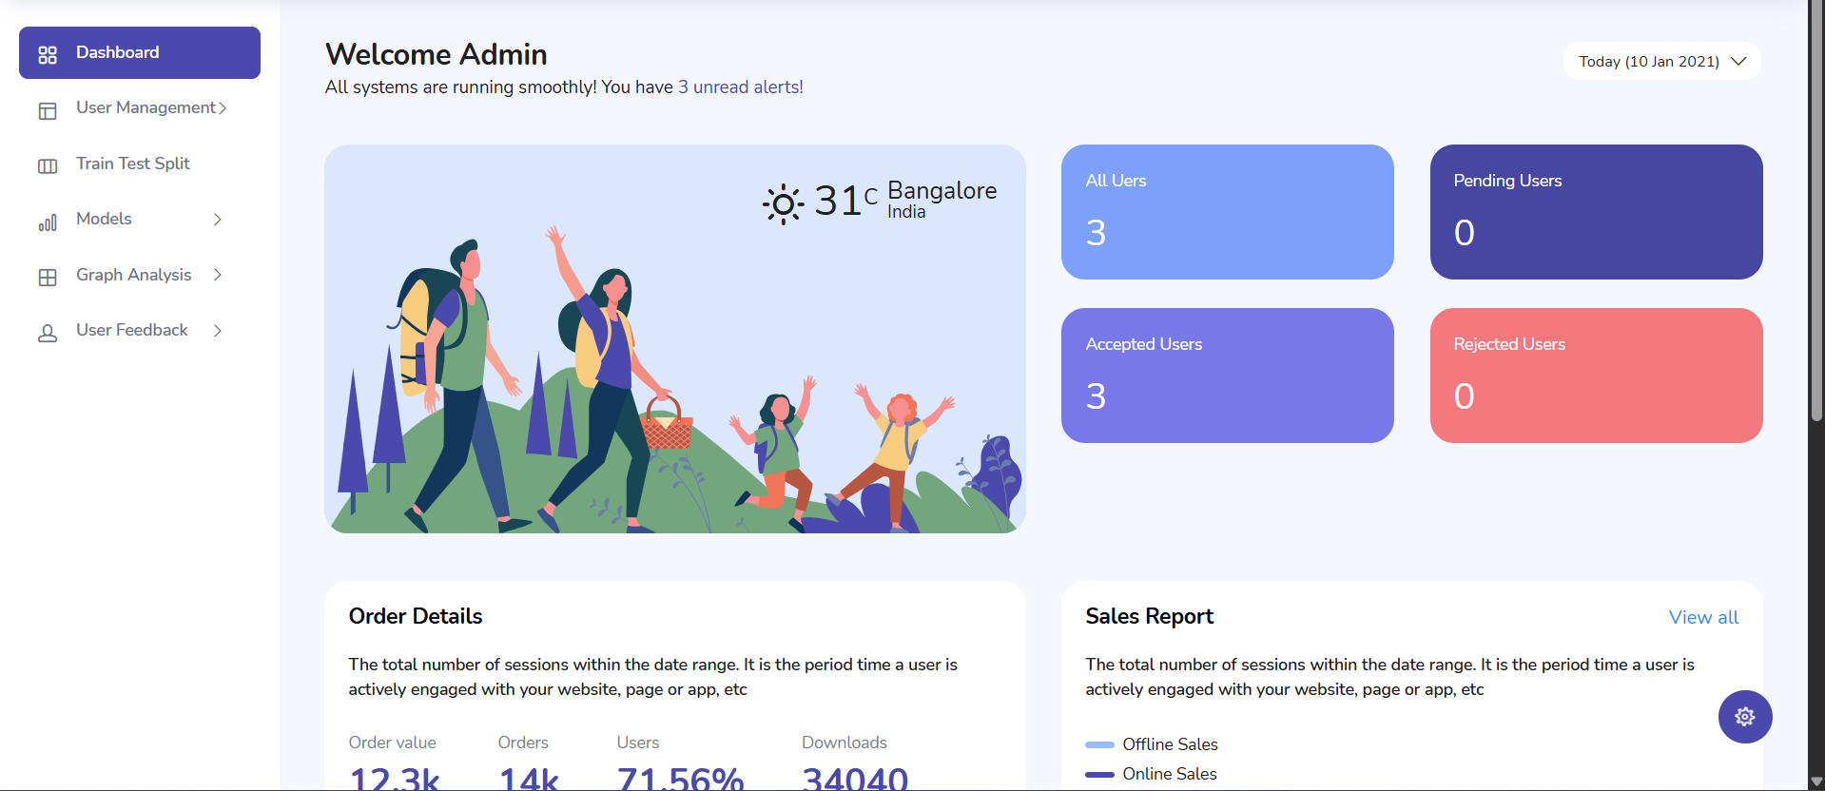
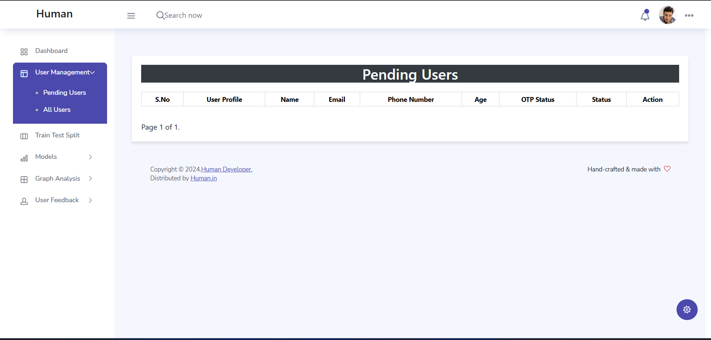
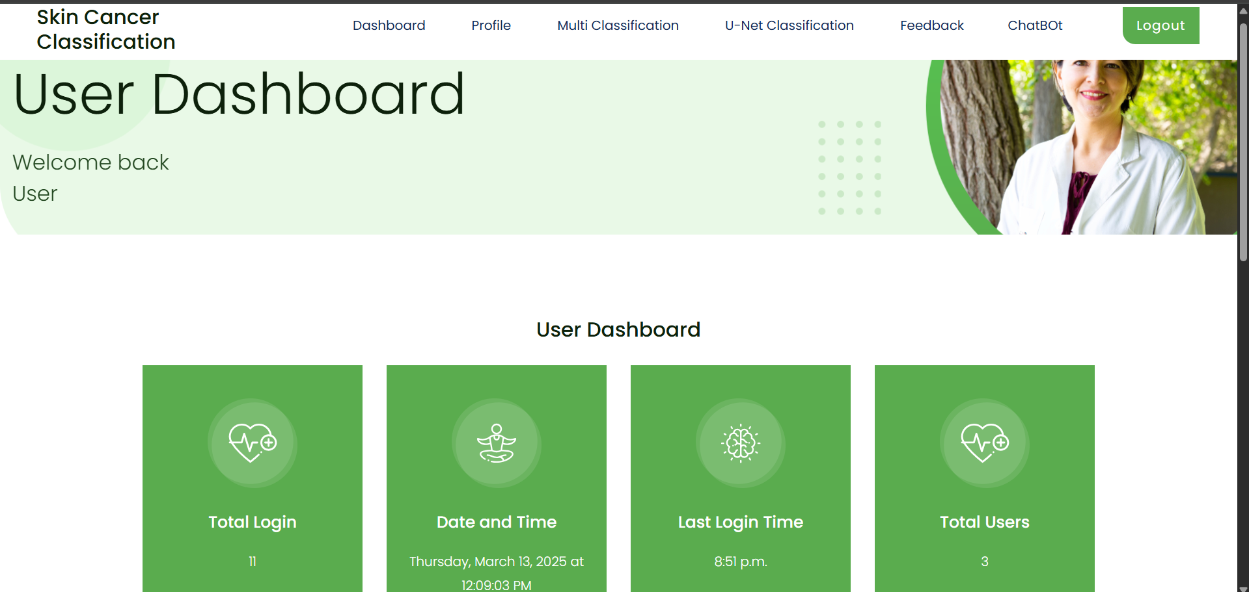
Multi Skin Cancer Classification and Segmentation
Multi Skin Cancer Classification and Segmentation

Slide 26
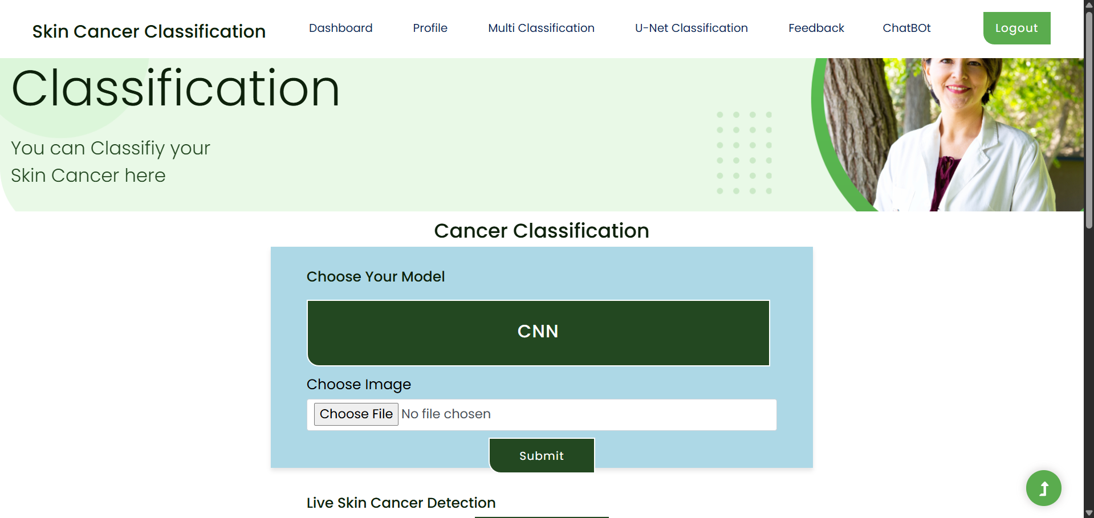
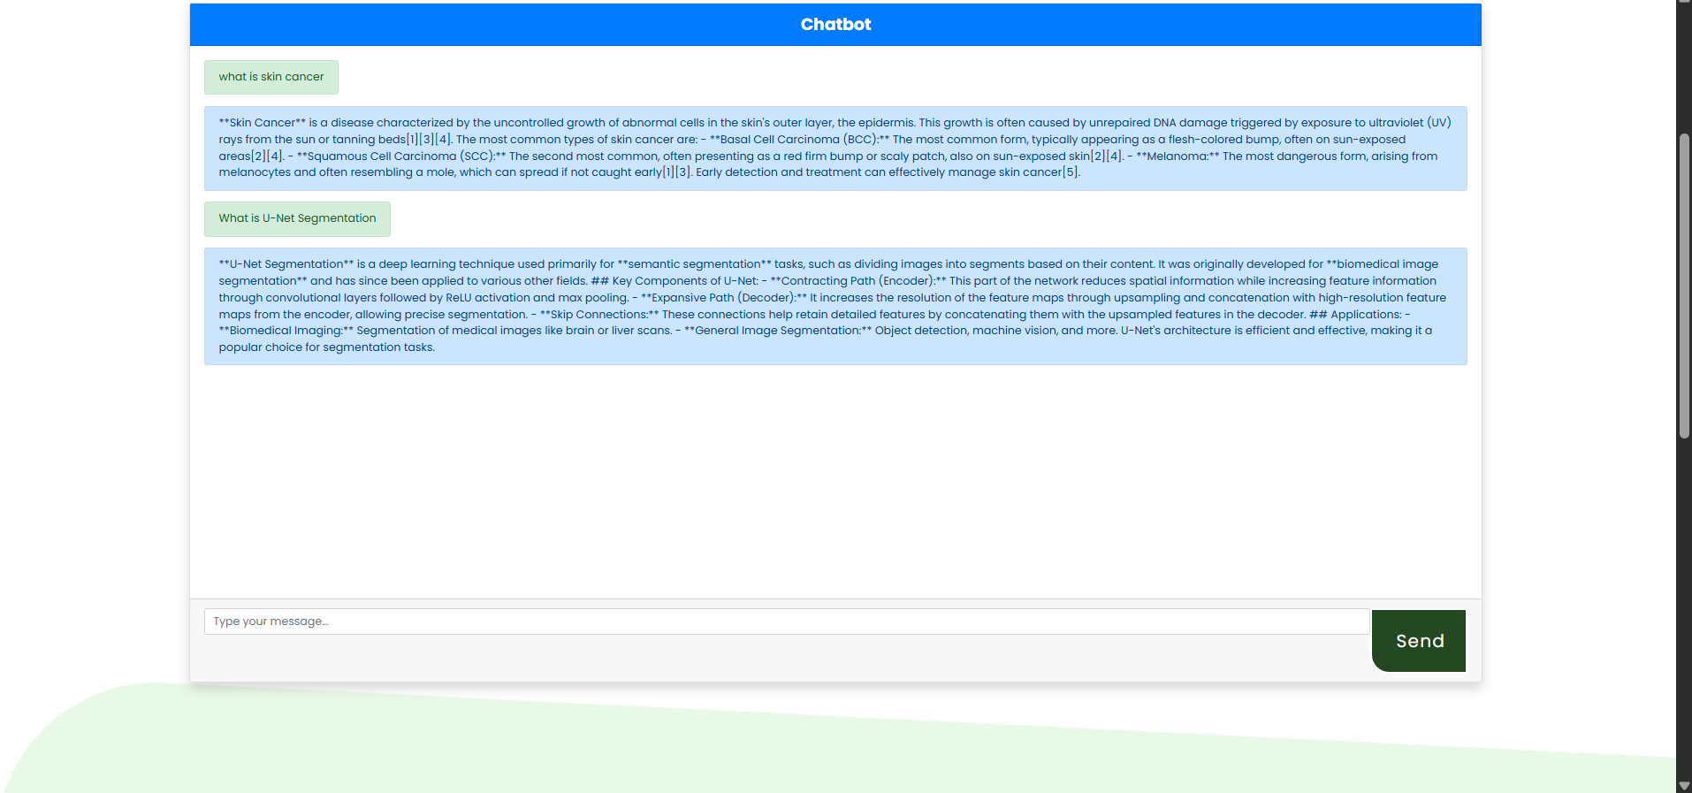
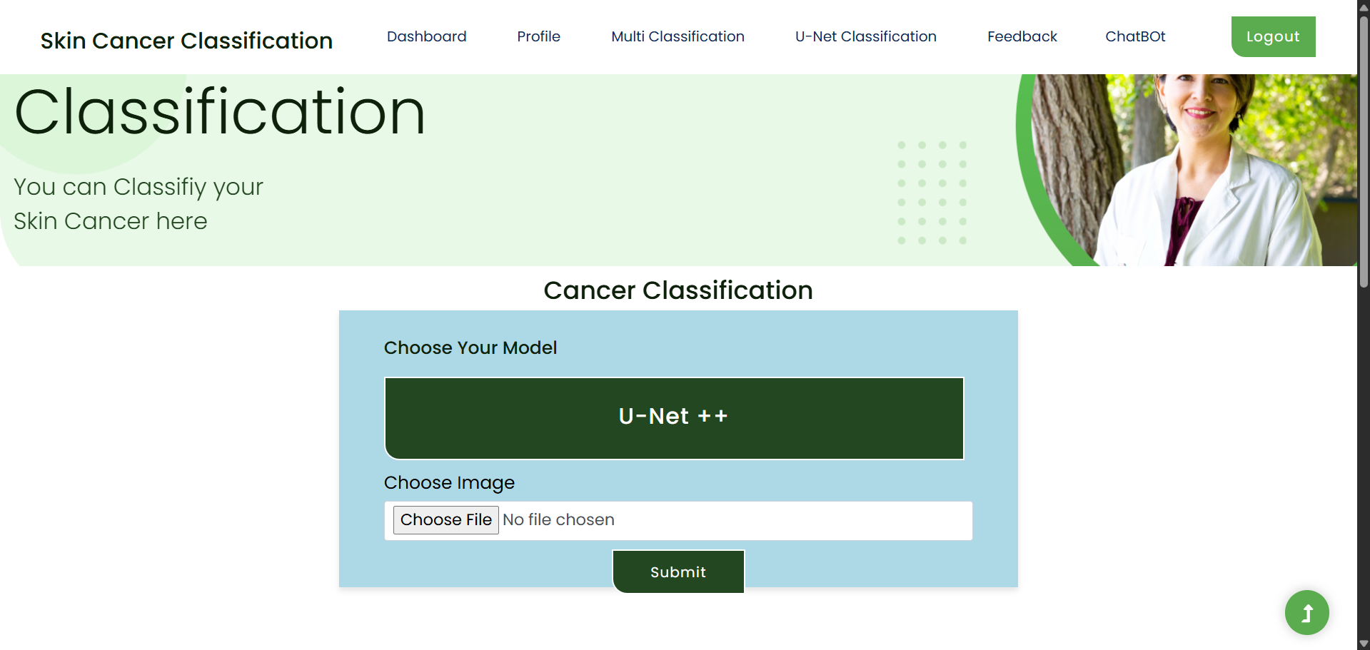
Multi Skin Cancer Classification and Segmentation
Multi Skin Cancer Classification and Segmentation

Slide 27
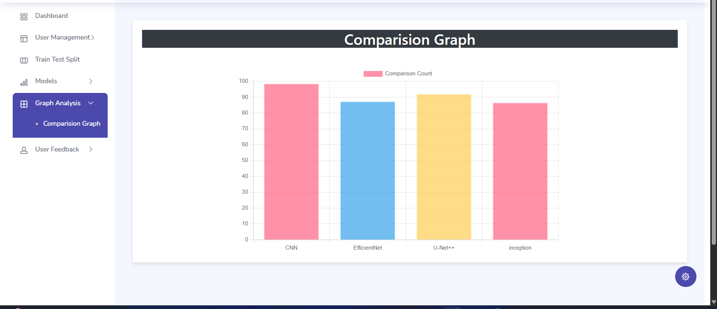
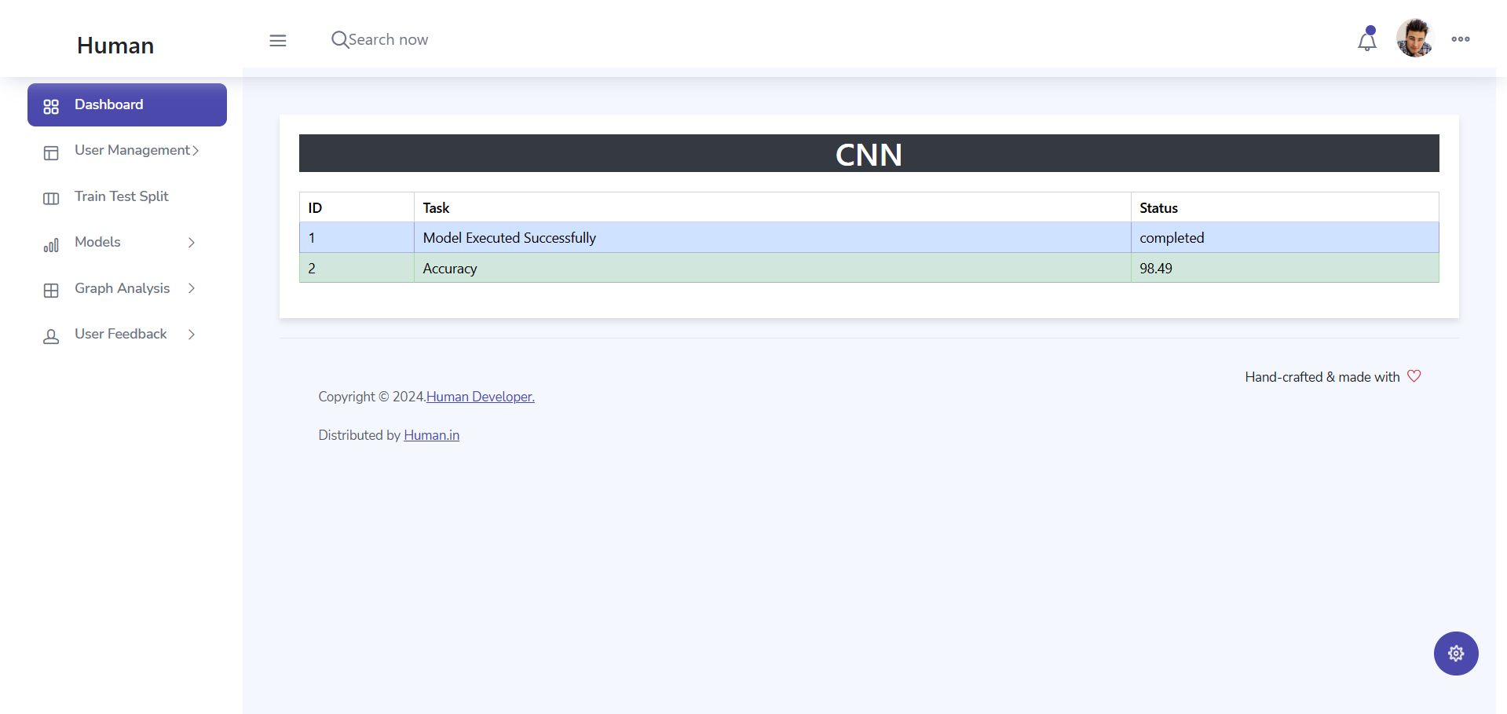
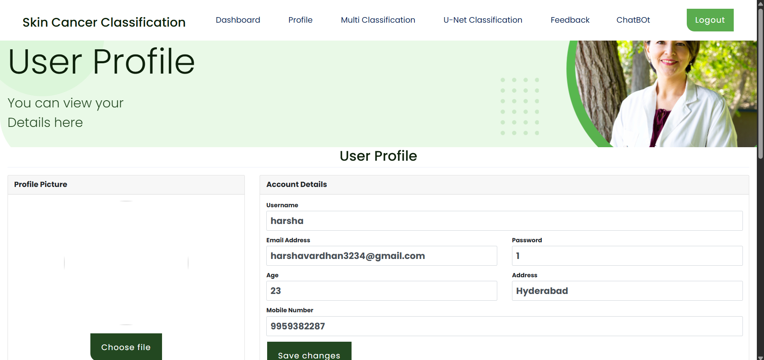
Multi Skin Cancer Classification and Segmentation
Multi Skin Cancer Classification and Segmentation

Slide 28
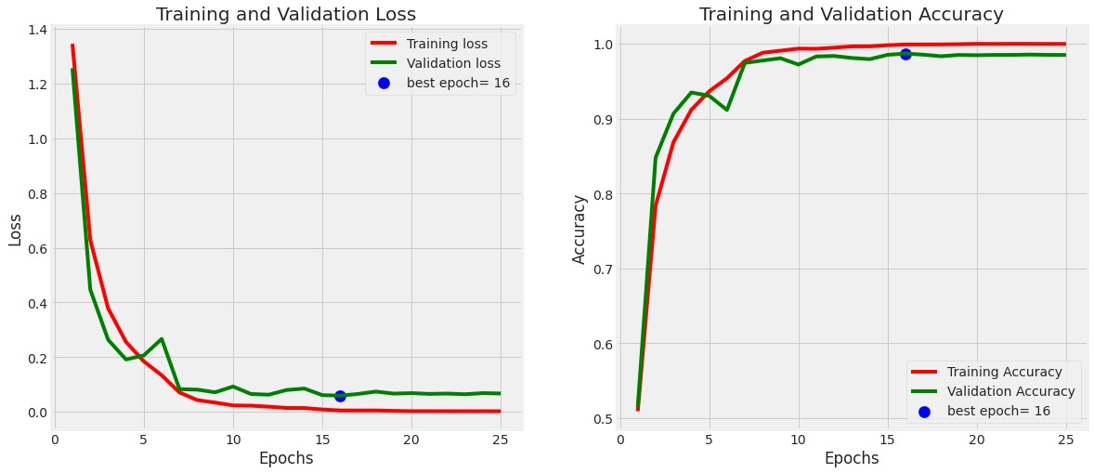
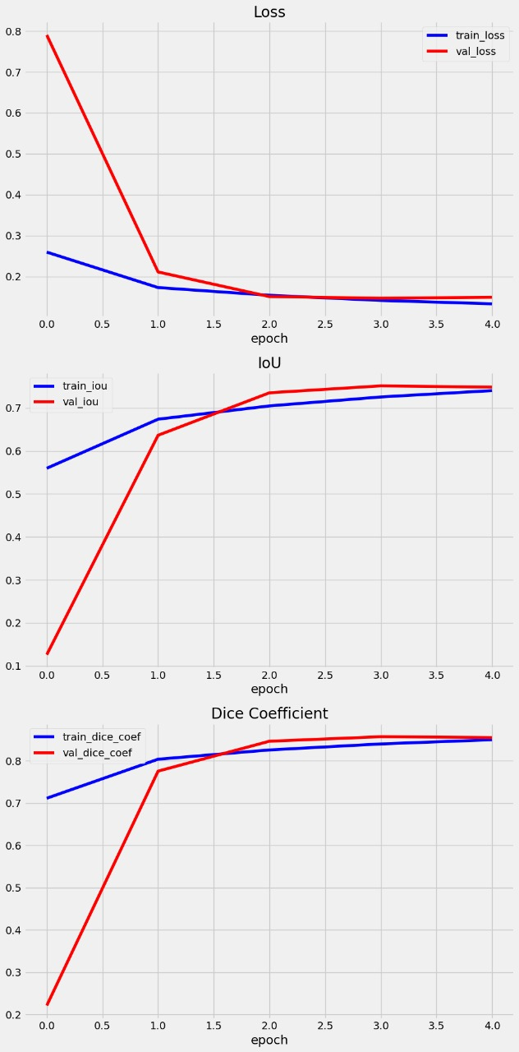
Multi Skin Cancer Classification and Segmentation
Multi Skin Cancer Classification and Segmentation

Slide 29
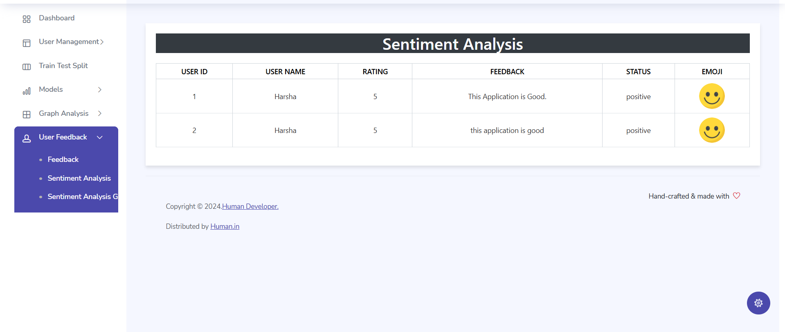
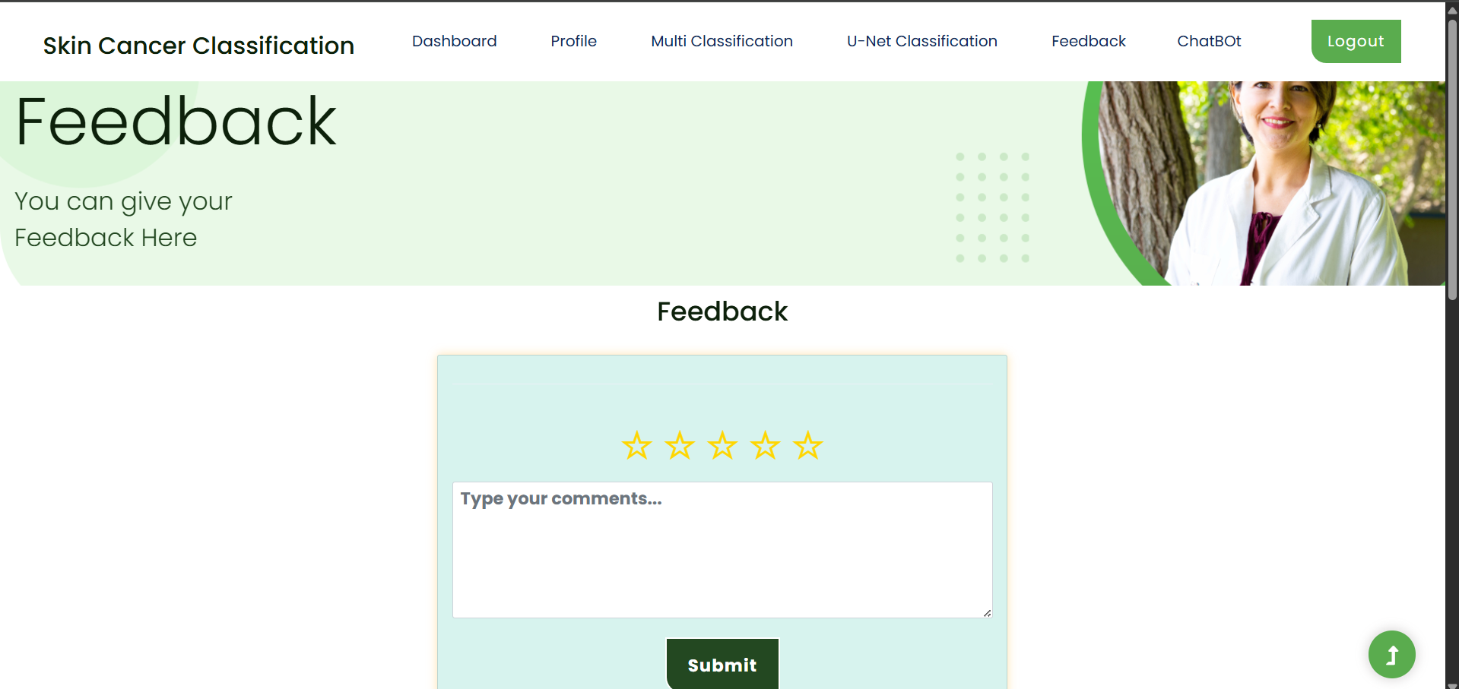
Multi Skin Cancer Classification and Segmentation
Multi Skin Cancer Classification and Segmentation

Slide 30
Multi Skin Cancer Classification and Segmentation
Challenges & Solutions
1.Challenge: Data Quality and Diversity
Problem: To train accurate models, a diverse dataset is required, including rare skin conditions and a wide range of skin tones. However, such datasets are often limited.
Solution: Data augmentation techniques, such as rotation, flipping, and scaling, are used to artificially increase dataset diversity. Additionally, incorporating public datasets like ISIC can help in building a robust training set.
2. Challenge: Model Generalization to Real-World Data
Problem: Deep learning models, particularly those for medical image analysis, may struggle to generalize when exposed to real-world data that differs from the training data.
Solution: The use of cross-validation and fine-tuning on diverse data sources helps the model adapt better to real-world variability in skin images.
3. Challenge: Variability in Skin Lesions
Problem: Skin lesions vary widely in shape, size, and appearance, which can make segmentation and classification challenging.
Solution: The U-Net++ model helps capture more fine-grained details of skin lesions. Additionally, increasing training data diversity and using multi-scale analysis improves the model’s ability to handle various lesion types.
Multi Skin Cancer Classification and Segmentation

Slide 31
Multi Skin Cancer Classification and Segmentation
Future Scope
Integration of Additional Skin Health Conditions: Expand the system to detect other conditions like eczema, psoriasis, and acne, offering broader skin health insights beyond just cancer.
Improvement in Segmentation Accuracy: Enhance segmentation using multi-scale methods or advanced models to better detect small, irregular lesions.
Real-Time Video Analysis: Enable continuous skin video capture for dynamic monitoring, allowing users to track lesion changes over time.
Integration with Wearable Devices: Integrate with devices like smartwatches to monitor skin health metrics (e.g., UV exposure, hydration), offering real-time alerts for skin care.
AI-Driven Personalized Recommendations: Provide personalized skin care and protection tips based on skin type, lesion history, and location, enhancing user experience.
Multi Skin Cancer Classification and Segmentation

Slide 32
Multi Skin Cancer Classification and Segmentation
Conclusion
The Multi Skin Cancer Classification and Segmentation system has successfully demonstrated the potential of artificial intelligence in transforming skin cancer detection. By integrating advanced deep learning models such as CNN for classification and U-Net++ for segmentation, the system provides accurate, real-time analysis of skin lesions, offering immediate feedback to users.
Key features such as real-time camera capture, image upload functionality, chatbot integration, and appointment booking enhance the user experience, making the platform not only a diagnostic tool but also a complete resource for skin health management. Multi-language support ensures the system is accessible to a global audience, breaking down barriers for users worldwide.
The successful implementation of this project has the potential to significantly improve early detection rates, enabling more people to seek timely medical consultation. By continuously improving the system with user feedback and ongoing advancements in AI, the platform can play a key role in reducing skin cancer mortality and improving overall skin health.
Multi Skin Cancer Classification and Segmentation

